Slide 1
Dynamic Interactions of COVID-19 Incidences, Mobility, Policy, and Vaccination in Seoul: A VARX Model Approach Oct 29, 2024 Zeyu Hu; Youngji Jo

Slide 2
Introduction
行业PPT模板http://www.1ppt.com/hangye/
COVID-19 Challenges: COVID-19 posed significant public health challenges globally, especially in densely populated cities with stringent policy measures.
Interrelated Dynamics: COVID-19 incidence, mobility, policy, and vaccination rates are closely linked. Early studies often missed how these interactions evolve over time.
Seoul as a Case Study: As a densely populated city, Seoul's dynamic environment requires understanding the varying impacts of policies over time and regions for better public health management.
Data: Using high-frequency telecom and policy data from July 2020 to November 2021, we examine the interactions between COVID-19 incidences, mobility, policies, and vaccination in 25 districts of Seoul.

Slide 3
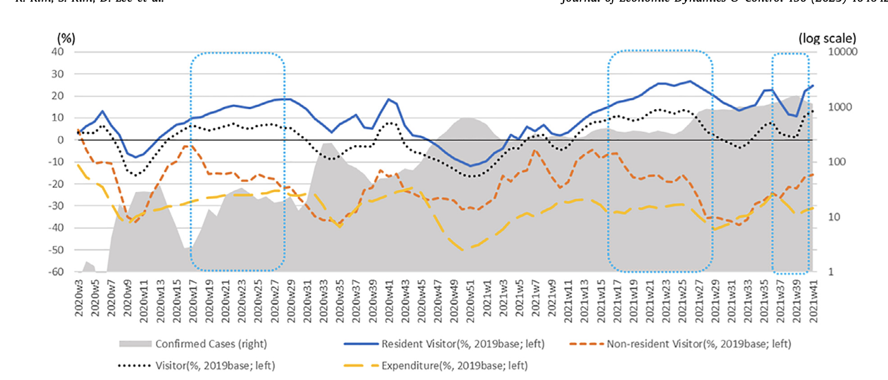
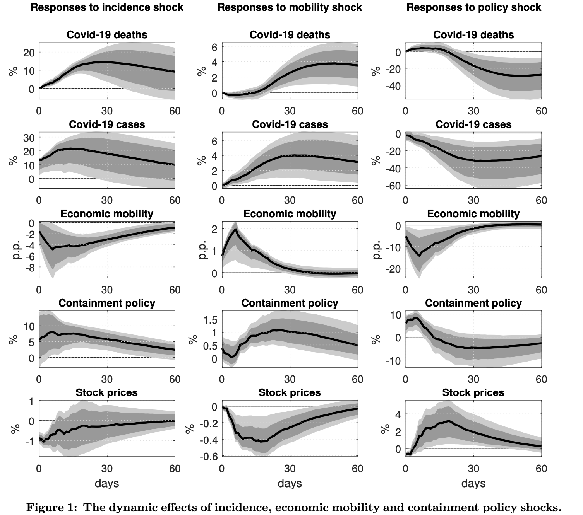
Existing evidence and motivation of the study
The study demonstrates that stricter social distancing policies in South Korea were associated with a significant reduction in COVID-19 cases and mobility, but also resulted in notable economic trade-offs, particularly in consumer spending (Kim, Kijin, et al. 2023).
The study illustrates the dynamic impacts of COVID-19 incidences, economic mobility, and containment policies across multiple dimensions. Notably, a shock in containment policy leads to a swift decrease in economic mobility, with a delayed but clear reduction in COVID-19 cases (Camehl and Rieth, 2021).
Existing studies either include extra variables or overlook vaccination, obscuring the unique interactions among incidences, mobility, policy, and vaccination.
No research has yet examined how these four factors interact at a district level within a single city, leaving gaps in understanding regional dynamics and local policy impacts.

Slide 4
Objective
行业PPT模板http://www.1ppt.com/hangye/
To quantify the dynamic relationship among incidence, movement and policy in terms of the initial response, and its direction and duration over time in overall and each district in Seoul based on the impulse response analysis in VAR model
To determine whether social distancing policies causally reduced COVID-19 incidence, and if so, through which pathways (e.g., direct reduction of incidence or indirect reduction via reduced mobility) in commercial and noncommercial districts in Seoul

Slide 5
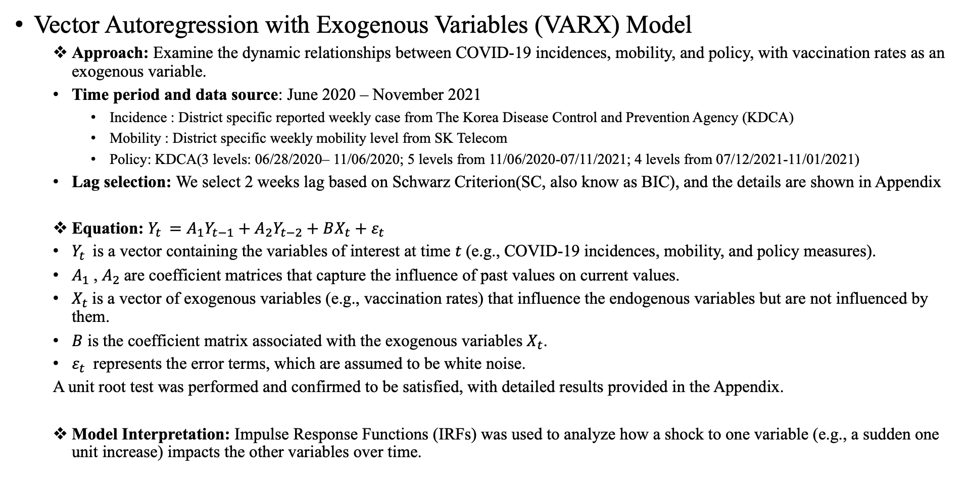
Methods
行业PPT模板http://www.1ppt.com/hangye/
Vector Autoregression with Exogenous Variables (VARX) Model
Approach: Examine the dynamic relationships between COVID-19 incidences, mobility, and policy, with vaccination rates as an exogenous variable.
Time period and data source: June 2020 – November 2021
Incidence : District specific reported weekly case from The Korea Disease Control and Prevention Agency (KDCA)
Mobility : District specific weekly mobility level from SK Telecom
Policy: KDCA(3 levels: 06/28/2020– 11/06/2020; 5 levels from 11/06/2020-07/11/2021; 4 levels from 07/12/2021-11/01/2021)
Lag selection: We select 2 weeks lag based on Schwarz Criterion(SC, also know as BIC), and the details are shown in Appendix
Equation: $Y_{t }=A_{1}Y_{t−1}+$ $A_{2}Y_{t−2}+BX_{t}+ε_{t}$
$Y_{t }$ is a vector containing the variables of interest at time 𝑡 (e.g., COVID-19 incidences, mobility, and policy measures).
$A_{1}$, $A_{2}$are coefficient matrices that capture the influence of past values on current values.
$X_{t}$is a vector of exogenous variables (e.g., vaccination rates) that influence the endogenous variables but are not influenced by them.
$B$ is the coefficient matrix associated with the exogenous variables $X_{t}$.
$ε_{t}$ represents the error terms, which are assumed to be white noise.
A unit root test was performed and confirmed to be satisfied, with detailed results provided in the Appendix.
Model Interpretation: Impulse Response Functions (IRFs) was used to analyze how a shock to one variable (e.g., a sudden one unit increase) impacts the other variables over time.
Notes:
https://www.phwr.org/journal/view.html?doi=10.56786/PHWR.2023.16.5.1

Slide 6
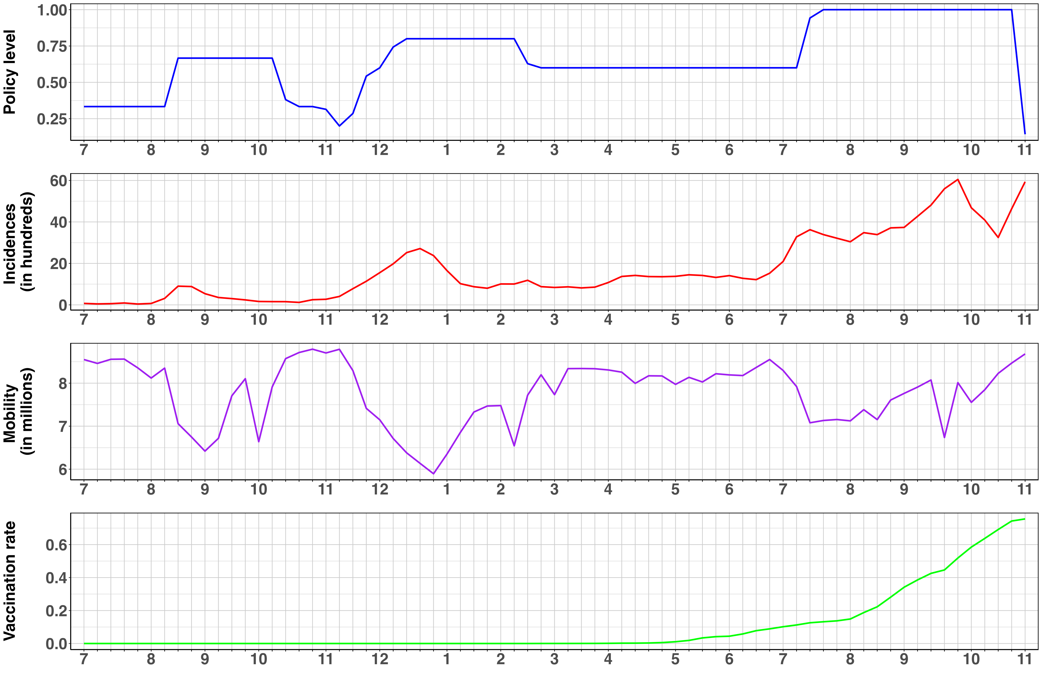
2020
2021

Slide 7
M.1 0.25
M.2 -0.08
Mobility
Vacc 2.22**
M.1 -2.09 M.2 2.24 *
I.1 -0.05** I.2 0.002
Vaccination
P.1 -2.05** P.2 1.25
M.1 -0.01 M.2 0.02
Vacc 16.69**
Vacc -0.58**
Incidence
Policy
P.1 1.74 P.2 2.54
I.1 1.24 **
I.2 -0.63 **
I.1 -0.003 I.2 0.02**
P.1 0.79 **
P.2 -0.19

Slide 8
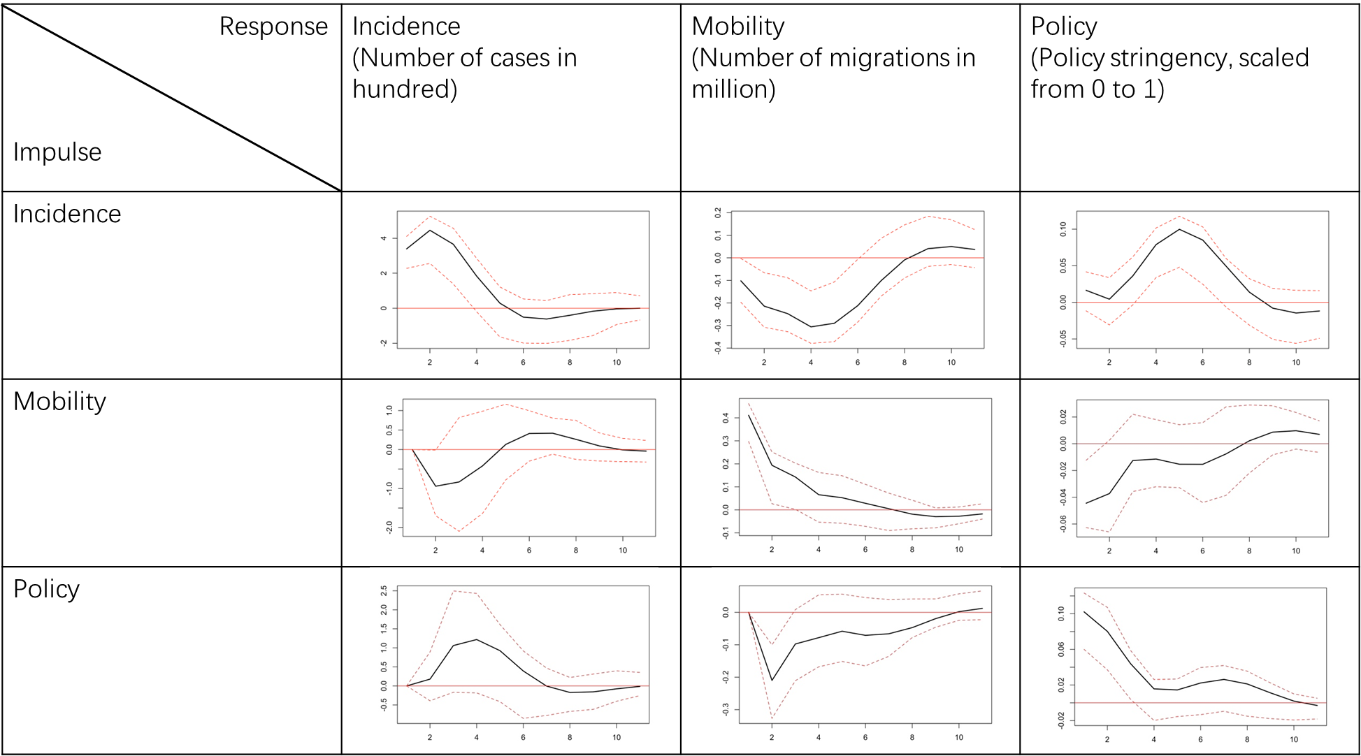
Incidence and Mobility: A rise in COVID-19 incidence led to an immediate reduction in mobility, with a decrease of 0.1 million in mobility per 100 new cases. This decline reflects the population's voluntary restriction of movement likely due to fear of infection. This reduced mobility persisted for about four weeks before gradually returning to previous levels.
Incidence and Policy Stringency: An increase in incidence triggered an immediate increase in policy stringency, with restrictions becoming more severe. This elevated policy stringency continued until the fifth week before gradually relaxing, likely as case numbers stabilized or declined.

Slide 9
Mobility and Incidence: An increase in mobility led to an immediate decrease in incidence which then begins to rise around the second week. This delayed increase aligns with the natural progression of disease transmission, where the incubation period can cause a lag in visible case numbers after an initial uptick in exposure due to increased mobility.
Mobility and Policy Stringency: Increased mobility contributed to a rise in policy stringency over time. This trend reflects a responsive adjustment in public health measures, where higher mobility levels—likely associated with higher transmission risks—triggered stricter policy interventions to curb potential outbreaks.

Slide 10
Policy Stringency and Mobility: An increase in policy stringency led to a reduction in mobility within approximately two weeks, demonstrating the immediate effect of social distancing policies on limiting movement.
Policy Stringency and Incidence: Following the increase in stringency, incidence rates initially rose gradually, possibly due to pre-existing exposures or transmission lag before the policy's effect fully manifested. However, a notable decline in incidence appeared after the fourth week, suggesting that the policy eventually curtailed transmission.

Slide 11
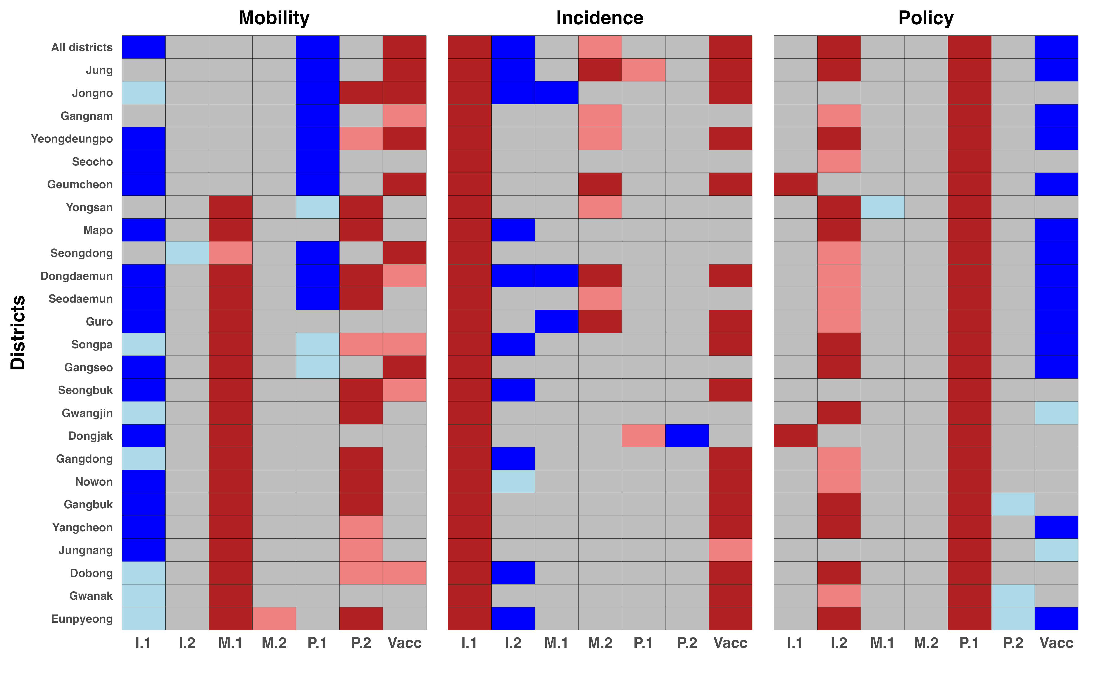
District-Level Comparative Heatmap Analysis
行业PPT模板http://www.1ppt.com/hangye/
Mobility
Rising COVID-19 cases led to reduced mobility, particularly in non-commercial districts, possibly due to heightened fear and self-restriction in response to continuous case increases.
Mobility levels from one week prior did not significantly impact current mobility in commercial districts, suggesting that movement in these areas may be more resilient to past mobility trends.
Policy interventions were notably effective in reducing mobility within commercial districts, likely due to stricter enforcement and higher population density in these areas, making compliance more impactful.
Higher vaccination rates were correlated with a significant increase in mobility, potentially indicating increased confidence in moving freely among vaccinated populations.

Slide 12
District-Level Comparative Heatmap Analysis
行业PPT模板http://www.1ppt.com/hangye/
Incidence
In some districts, incidences from two weeks ago are negatively associated with current incidences, which may suggest temporary reductions in transmission following previous spikes or enhanced public health measures.
Mobility levels in commercial districts from two weeks prior demonstrate a positive correlation with current incidences, indicating that past increases in mobility could contribute to subsequent transmission rates.
Policies appear to have had minimal direct effects on COVID-19 incidence, (but they have significantly influenced incidence rates indirectly by reducing mobility).
Vaccination rates are positively correlated with incidences, likely influenced by the emergence of the Delta variant, which drove both transmission rates and vaccination uptake simultaneously.

Slide 13
District-Level Comparative Heatmap Analysis
行业PPT模板http://www.1ppt.com/hangye/
Policy
COVID-19 incidences from two weeks prior are strongly correlated with stricter policy measures, indicating that policy adjustments were reactive to earlier increases in cases.
Mobility levels did not significantly influence policy changes.
A negative correlation exists between vaccination rates and policy stringency, likely due to a gradual relaxation of policies as vaccination coverage increased, reflecting greater confidence in population immunity.

Slide 14
Implications
行业PPT模板http://www.1ppt.com/hangye/
Effect from Incidence
The immediate decrease in mobility with rising incidence, especially in non-commercial areas, implies that public awareness and voluntary behavior changes effectively reduce movement, highlighting the role of community response in controlling the spread.
Since higher incidence 2 weeks ago lead to stricter policies, governments should consider proactive policies when cases start to increase, rather than waiting for further escalation.
Effect from Mobility
The minimal impact of one-week-prior mobility on commercial areas indicates these districts adhere closely to policy measures, which diminishes time-lagged effects—a positive outcome that can be leveraged to control the epidemic effectively.
The positive correlation between two-week-prior mobility and current incidence in commercial areas indicates that increased mobility leads to later rises in cases, highlighting the importance of early mobility restrictions in these areas.
Effect from Policy
The reduction in mobility within commercial districts from stricter policies suggests that targeted restrictions in these high-traffic zones effectively control spread. While for non-commercial areas, regular testing or such targeted public health measures could be helpful to control incidences.
Policies may need more than two weeks to impact incidence rates. While they reduce mobility, their slower effect on transmission highlights the importance of implementing restrictions proactively to allow measurable decreases in cases.

Slide 15
Discussions
Strengths
Comprehensive VARX Analysis: Incorporates multiple variables (incidences, mobility, policy) with vaccination rates as an exogenous factor, providing a detailed dynamic view of interrelationships across all regions in Seoul.
Quantitative Insights: Provides clear, quantifiable effects over time, allowing policymakers to estimate the lagged effects of policy changes and different resilience levels across districts.
Limitations
Generalizability: Findings may not fully generalize across different pandemic stages (early vs. late) due to evolving factors such as public compliance, vaccination rates, and viral variants.
Lag Assumption: The fixed 2-week lag enhances model interpretability but may sacrifice the ability to capture longer-term underlying influences, potentially overlooking extended effects across different pandemic phases.
Alternative approach
Structural VAR: By imposing theory-based restrictions, can enhance causal inference and reveal more nuanced pathways between variables.
Non-parametric Approach: Machine learning models that could capture non-linear relationships and interactions.
Practical Implications
Policy Planning: Findings highlight the need for region-specific strategies—such as implementing stricter controls in commercial areas, while focusing on testing and public awareness in non-commercial regions to encourage voluntary compliance. This approach leverages localized policy to effectively curb the spread of the pandemic.
Public Compliance: Understanding how quickly mobility rebounds following policy changes can guide strategies to improve sustained public compliance with health advisories and restrictions.

Slide 16
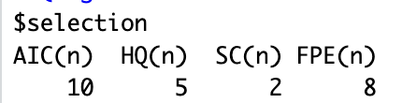
Appendix: Lag selection
行业PPT模板http://www.1ppt.com/hangye/
Criteria | 1 | 2 | 3 | 4 | 5 | 6 | 7 | 8 | 9 | 10
AIC(n) | -2.71 | -3.07 | -3.11 | -3.55 | -3.72 | -3.75 | -3.79 | -4.05 | -4.03 | -4.15
HQ(n) | -2.51 | -2.74 | -2.66 | -2.98 | -3.03 | -2.94 | -2.86 | -2.99 | -2.85 | -2.85
SC(n) | -2.19 | -2.24 | -1.96 | -2.10 | -1.96 | -1.67 | -1.40 | -1.35 | -1.02 | -0.83
FPE(n) | 0.07 | 0.05 | 0.05 | 0.03 | 0.03 | 0.03 | 0.03 | 0.02 | 0.02 | 0.02
We selected a 2-week lag based on the SC because it emphasizes model simplicity and minimizes the risk of overfitting, also aligns with the practical considerations in pandemic studies, where policy effects often manifest over a short period. Consistent with our approach, a 2-week lag was also optimal in all other regions analyzed, ensuring comparability of results.

Slide 17
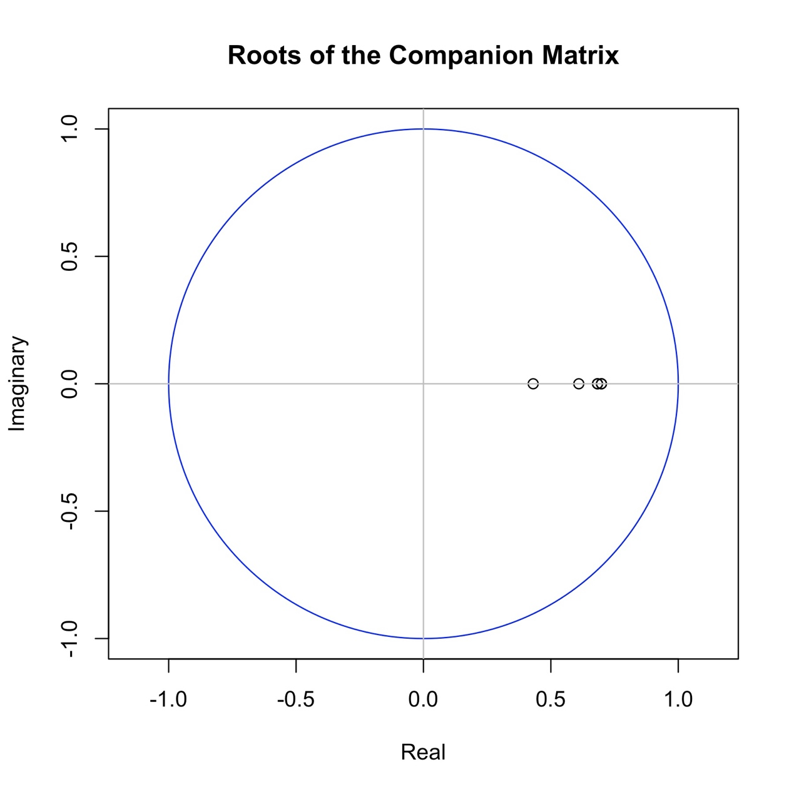
Appendix: Unit root test
行业PPT模板http://www.1ppt.com/hangye/
Roots of the characteristic polynomial: 0.6985 0.6985 0.6831 0.6831 0.6097 0.4306
Since all the points lie within the unit circle, this confirms the stability of the coefficients and further validates the robustness of our results.
This stability check was performed across all models in each district, with all results confirming stability.

Slide 18
Estimation results for equation mobility:
mobility = incidences.l1 + mobility.l1 + policy.l1 + incidences.l2 + mobility.l2 + policy.l2 + const + trend + vaccination_rate
DIST | Incidence.l1 | Incidence.l2 | Mobility.l1 | Mobility.l2 | Policy.l1 | Policy.l2 | Vacc_rate
Total | -0.046 (0.014)** | 0.002 (0.016) | 0.249 (0.158) | 0.075 (0.152) | -2.054 (0.910)** | 1.249 (0.819) | 2.225 (0.694)**
Jung | -0.058 (0.040) | -0.048 (0.044) | -0.035 (0.157) | -0.157 (0.157) | -0.375 (0.093)** | 0.091 (0.082) | 0.249 (0.068)**
Jongno | -0.069 (0.036)* | -0.001 (0.036) | 0.246 (0.176) | 0.086 (0.180) | -0.263 (0.089)** | 0.155 (0.077)** | 0.178 (0.078)**
Gangnam | -0.061 (0.038) | 0.028 (0.041) | 0.080 (0.148) | -0.069 (0.149) | -0.561 (0.176)** | 0.093 (0.164) | 0.186 (0.094)*
Yeongdeungpo | -0.033 (0.015)** | -0.026 (0.017) | 0.237 (0.149) | 0.088 (0.149) | -0.140 (0.063)** | 0.104 (0.056)* | 0.143 (0.046)**
Seocho | -0.076 (0.030)** | 0.026 (0.032) | 0.120 (0.148) | 0.034 (0.148) | -0.254 (0.100)** | 0.040 (0.091) | 0.074 (0.049)
Geumcheon | -0.032 (0.011)** | -0.010 (0.013) | -0.102 (0.136) | -0.126 (0.135) | -0.048 (0.020)** | 0.002 (0.019) | 0.084 (0.024)**
Yongsan | -0.019 (0.012) | -0.003 (0.013) | 0.597 (0.160)** | 0.189 (0.168) | -0.062 (0.036)* | 0.080 (0.033)** | 0.017 (0.020)
Mapo | -0.042 (0.016)** | 0.008 (0.017) | 0.543 (0.151)** | 0.251 (0.154) | -0.067 (0.060) | 0.123 (0.053)** | 0.030 (0.034)
Seongdong | -0.015 (0.012) | -0.022 (0.012)* | 0.287 (0.151)* | 0.044 (0.152) | -0.069 (0.034)** | 0.033 (0.031) | 0.043 (0.019)**
Dongdaemun | -0.014 (0.005)** | 0.004 (0.006) | 0.498 (0.146)** | 0.134 (0.145) | -0.063 (0.024)** | 0.059 (0.022)** | 0.034 (0.020)*
Seodaemun | -0.028 (0.010)** | 0.008 (0.011) | 0.504 (0.152)** | 0.100 (0.150) | -0.053 (0.026)** | 0.052 (0.023)** | 0.023 (0.017)
Guro | -0.014 (0.006)** | 0.005 (0.006) | 0.664 (0.145)** | -0.237 (0.144) | -0.037 (0.027) | 0.009 (0.027) | 0.041 (0.030)
Songpa | -0.014 (0.008)* | -0.002 (0.009) | 0.522 (0.167)** | 0.128 (0.172) | -0.103 (0.057)* | 0.099 (0.050)* | 0.064 (0.036)*
Gangseo | -0.012 (0.005)** | -0.007 (0.006) | 0.468 (0.161)** | -0.020 (0.150) | -0.050 (0.027)* | 0.032 (0.026) | 0.055 (0.019)**
Seongbuk | -0.015 (0.004)** | -0.001 (0.005) | 0.782 (0.156)** | 0.120 (0.152) | -0.004 (0.016) | 0.033 (0.015)** | 0.025 (0.013)*
Gwangjin | -0.008 (0.005)* | -0.002 (0.005) | 0.866 (0.144)** | 0.177 (0.160) | -0.013 (0.021) | 0.059 (0.020)** | -0.002 (0.012)
Dongjak | -0.022 (0.007)** | 0.008 (0.008) | 0.691 (0.153)** | 0.125 (0.155) | -0.004 (0.023) | 0.026 (0.022) | 0.011 (0.012)
Gangdong | -0.009 (0.005)* | -0.001 (0.005) | 0.699 (0.163)** | 0.176 (0.165) | -0.027 (0.019) | 0.047 (0.017)** | 0.016 (0.013)
Nowon | -0.015 (0.006)** | -0.002 (0.006) | 0.723 (0.153)** | 0.148 (0.152) | -0.017 (0.020) | 0.043 (0.019)** | 0.018 (0.014)
Gangbuk | -0.012 (0.005)** | 0.000 (0.005) | 0.625 (0.145)** | 0.166 (0.144) | -0.017 (0.013) | 0.031 (0.012)** | 0.017 (0.011)
Yangcheon | -0.019 (0.005)** | 0.006 (0.005) | 0.798 (0.139)** | -0.076 (0.132) | -0.019 (0.014) | 0.027 (0.014)* | 0.011 (0.009)
Jungnang | -0.011 (0.004)** | 0.003 (0.004) | 0.515 (0.138)** | 0.224 (0.134) | -0.011 (0.012) | 0.020 (0.011)* | 0.007 (0.008)
Dobong | -0.007 (0.004)* | -0.005 (0.005) | 0.545 (0.129)** | 0.172 (0.134) | -0.015 (0.011) | 0.020 (0.010)* | 0.014 (0.008)*
Gwanak | -0.007 (0.003)* | 0.001 (0.004) | 0.891 (0.153)** | -0.096 (0.157) | -0.011 (0.021) | 0.029 (0.019) | 0.007 (0.010)
Eunpyeong | -0.007 (0.004)* | 0.003 (0.004) | 0.525 (0.132)** | 0.230 (0.137)* | -0.021 (0.013) | 0.028 (0.012)** | 0.006 (0.009)

Slide 19
Estimation results for equation mobility:
incidences = incidences.l1 + mobility.l1 + policy.l1 + incidences.l2 + mobility.l2 + policy.l2 + const + trend + vaccination_rate
DIST | Incidence.l1 | Incidence.l2 | Mobility.l1 | Mobility.l2 | Policy.l1 | Policy.l2 | Vacc_rate
Total | 1.242 (0.110)** | -0.632 (0.129)** | -2.095 (1.263) | 2.238 (1.220)* | 1.747 (7.290) | 2.538 (6.559) | 16.688 (5.560)**
Jung | 1.102 (0.100)** | -0.590 (0.108)** | 0.016 (0.391) | 0.797 (0.391)** | 0.422 (0.230)* | 0.010 (0.204) | 0.386 (0.168)**
Jongno | 0.905 (0.128)** | -0.428 (0.130)** | -1.323 (0.626)** | 0.034 (0.640) | -0.135 (0.318) | -0.129 (0.275) | 0.748 (0.279)**
Gangnam | 0.867 (0.125)** | 0.024 (0.134) | -0.366 (0.488) | 0.963 (0.491)* | -0.791 (0.583) | 0.748 (0.543) | -0.359 (0.309)
Yeongdeungpo | 0.504 (0.130)** | 0.222 (0.142) | -1.077 (1.275) | 2.500 (1.274)* | 0.688 (0.543) | -0.359 (0.476) | 0.928 (0.398)**
Seocho | 0.853 (0.130)** | -0.074 (0.136) | 0.211 (0.638) | 0.465 (0.636) | 0.024 (0.432) | -0.241 (0.392) | 0.172 (0.210)
Geumcheon | 0.548 (0.161)** | -0.134 (0.180) | -0.862 (1.917) | 4.808 (1.895)** | 0.463 (0.280) | -0.060 (0.269) | 1.231 (0.335)**
Yongsan | 0.588 (0.126)** | -0.054 (0.132) | -2.322 (1.684) | 3.292 (1.776)* | 0.240 (0.384) | -0.034 (0.345) | 0.023 (0.214)
Mapo | 1.082 (0.126)** | -0.388 (0.139)** | -0.579 (1.216) | 0.065 (1.241) | 0.042 (0.481) | -0.205 (0.425) | 0.309 (0.275)
Seongdong | 0.529 (0.133)** | 0.013 (0.140) | -0.681 (1.698) | 2.418 (1.712) | 0.233 (0.379) | -0.083 (0.343) | 0.225 (0.210)
Dongdaemun | 0.833 (0.112)** | -0.494 (0.120)** | -8.239 (3.009)** | 8.891 (2.993)** | -0.148 (0.503) | 0.506 (0.456) | 1.702 (0.405)**
Seodaemun | 0.667 (0.131)** | 0.046 (0.158) | -2.436 (2.092) | 3.929 (2.074)* | 0.451 (0.352) | -0.262 (0.315) | 0.111 (0.234)
Guro | 0.642 (0.120)** | -0.101 (0.125) | -9.015 (2.796)** | 9.902 (2.784)** | -0.211 (0.516) | 0.577 (0.515) | 2.231 (0.581)**
Songpa | 1.016 (0.118)** | -0.507 (0.128)** | -0.799 (2.460) | 1.632 (2.538) | 0.221 (0.847) | 0.142 (0.738) | 1.241 (0.531)**
Gangseo | 0.825 (0.141)** | -0.060 (0.155) | -2.703 (4.360) | 2.034 (4.054) | -0.419 (0.720) | -0.145 (0.703) | 0.825 (0.510)
Seongbuk | 0.699 (0.138)** | -0.574 (0.152)** | -8.176 (5.003) | 2.380 (4.867) | -0.097 (0.505) | -0.144 (0.487) | 2.094 (0.424)**
Gwangjin | 0.475 (0.127)** | 0.138 (0.136) | -4.049 (3.769) | 6.533 (4.178) | 0.249 (0.554) | 0.212 (0.519) | -0.004 (0.318)
Dongjak | 0.780 (0.127)** | 0.019 (0.139) | 2.418 (2.815) | -3.052 (2.856) | 0.774 (0.434)* | -1.157 (0.398)** | 0.280 (0.229)
Gangdong | 0.545 (0.124)** | -0.303 (0.130)** | -2.378 (4.051) | 1.345 (4.109) | 0.647 (0.462) | -0.645 (0.428) | 1.585 (0.335)**
Nowon | 0.568 (0.133)** | -0.268 (0.144)* | -2.999 (3.678) | -1.675 (3.642) | 0.059 (0.472) | -0.641 (0.451) | 1.481 (0.335)**
Gangbuk | 0.612 (0.143)** | -0.228 (0.148) | 0.276 (4.421) | -1.560 (4.387) | 0.135 (0.411) | -0.125 (0.381) | 0.978 (0.327)**
Yangcheon | 0.782 (0.146)** | -0.221 (0.167) | -0.975 (4.453) | -1.565 (4.219) | 0.263 (0.459) | -0.309 (0.443) | 0.614 (0.282)**
Jungnang | 0.683 (0.143)** | -0.208 (0.157) | -2.904 (5.560) | 0.003 (5.426) | 0.363 (0.494) | -0.353 (0.452) | 0.551 (0.316)*
Dobong | 0.703 (0.122)** | -0.308 (0.136)** | 2.257 (3.832) | -3.408 (3.988) | 0.416 (0.338) | -0.435 (0.305) | 0.772 (0.224)**
Gwanak | 0.822 (0.140)** | -0.101 (0.145) | -6.201 (6.173) | 2.750 (6.365) | 0.220 (0.832) | -0.703 (0.785) | 0.874 (0.406)**
Eunpyeong | 0.935 (0.145)** | -0.445 (0.163)** | -2.770 (4.855) | 1.384 (5.043) | 0.551 (0.472) | -0.353 (0.429) | 0.894 (0.326)**

Slide 20
Estimation results for equation policy:
policy = incidences.l1 + mobility.l1 + policy.l1 + incidences.l2 + mobility.l2 + policy.l2 + const + trend
DIST | Incidence.l1 | Incidence.l2 | Mobility.l1 | Mobility.l2 | Policy.l1 | Policy.l2 | Vacc_rate
Total | -0.003 (0.004) | 0.014 (0.004)** | -0.006 (0.042) | 0.016 (0.041) | 0.785 (0.242)** | -0.195 (0.218) | -0.576 (0.185)**
Jung | -0.010 (0.105) | 0.239 (0.113)** | -0.411 (0.408) | 0.049 (0.409) | 0.876 (0.241)** | -0.230 (0.213) | -0.408 (0.175)**
Jongno | 0.051 (0.112) | -0.001 (0.113) | -0.798 (0.547) | -0.348 (0.560) | 0.721 (0.278)** | -0.286 (0.240) | -0.124 (0.244)
Gangnam | 0.031 (0.048) | 0.093 (0.052)* | -0.173 (0.190) | -0.051 (0.191) | 0.693 (0.226)** | -0.045 (0.211) | -0.275 (0.120)**
Yeongdeungpo | 0.020 (0.058) | 0.134 (0.064)** | -0.633 (0.572) | -0.184 (0.572) | 0.721 (0.244)** | -0.251 (0.214) | -0.498 (0.179)**
Seocho | 0.001 (0.077) | 0.145 (0.081)* | -0.294 (0.378) | -0.135 (0.377) | 0.694 (0.256)** | -0.102 (0.232) | -0.155 (0.125)
Geumcheon | 0.334 (0.123)** | 0.058 (0.137) | -0.054 (1.456) | -0.003 (1.439) | 0.851 (0.213)** | -0.200 (0.204) | -0.850 (0.255)**
Yongsan | 0.080 (0.082) | 0.180 (0.087)** | -2.187 (1.101)* | 0.674 (1.161) | 0.558 (0.251)** | -0.036 (0.226) | -0.186 (0.140)
Mapo | -0.037 (0.063) | 0.227 (0.070)** | -0.329 (0.612) | -0.044 (0.624) | 0.740 (0.242)** | -0.220 (0.214) | -0.339 (0.138)**
Seongdong | 0.055 (0.083) | 0.170 (0.088)* | -1.524 (1.067) | -0.295 (1.076) | 0.650 (0.238)** | -0.091 (0.216) | -0.285 (0.132)**
Dongdaemun | 0.011 (0.053) | 0.101 (0.057)* | -0.744 (1.427) | -0.794 (1.420) | 0.901 (0.238)** | -0.250 (0.216) | -0.410 (0.192)**
Seodaemun | 0.140 (0.086) | 0.206 (0.103)* | -0.237 (1.364) | -0.262 (1.352) | 0.763 (0.230)** | -0.223 (0.205) | -0.429 (0.152)**
Guro | 0.049 (0.053) | 0.094 (0.056)* | -0.383 (1.244) | 0.563 (1.239) | 0.976 (0.230)** | -0.241 (0.229) | -0.841 (0.258)**
Songpa | -0.044 (0.035) | 0.116 (0.038)** | -1.011 (0.734) | 0.276 (0.757) | 0.775 (0.253)** | -0.171 (0.220) | -0.318 (0.158)**
Gangseo | -0.023 (0.052) | 0.134 (0.057)** | 0.327 (1.592) | 0.161 (1.480) | 0.947 (0.263)** | -0.201 (0.257) | -0.384 (0.186)**
Seongbuk | -0.024 (0.070) | 0.115 (0.077) | -2.431 (2.552) | -0.185 (2.482) | 0.675 (0.257)** | -0.157 (0.248) | -0.236 (0.216)
Gwangjin | 0.076 (0.055) | 0.145 (0.059)** | -1.895 (1.628) | -1.032 (1.805) | 0.579 (0.240)** | -0.224 (0.224) | -0.245 (0.137)*
Dongjak | 0.154 (0.077)** | -0.001 (0.084) | -0.531 (1.706) | -1.483 (1.730) | 0.682 (0.263)** | -0.204 (0.241) | -0.213 (0.139)
Gangdong | -0.114 (0.070) | 0.146 (0.074)* | -2.866 (2.295) | -0.935 (2.328) | 0.768 (0.262)** | -0.284 (0.242) | -0.139 (0.190)
Nowon | -0.109 (0.073) | 0.140 (0.079)* | -1.052 (2.011) | -1.581 (1.991) | 0.896 (0.258)** | -0.389 (0.246) | -0.077 (0.183)
Gangbuk | -0.078 (0.083) | 0.194 (0.086)** | 0.249 (2.569) | -0.858 (2.548) | 1.107 (0.239)** | -0.371 (0.221)* | -0.306 (0.190)
Yangcheon | 0.044 (0.073) | 0.198 (0.084)** | 1.242 (2.230) | -1.061 (2.113) | 0.880 (0.230)** | -0.292 (0.222) | -0.351 (0.141)**
Jungnang | 0.106 (0.069) | 0.054 (0.075) | 1.477 (2.667) | -3.602 (2.603) | 0.871 (0.237)** | -0.291 (0.217) | -0.258 (0.151)*
Dobong | -0.118 (0.077) | 0.254 (0.086)** | -0.466 (2.418) | -3.413 (2.516) | 0.828 (0.213)** | -0.257 (0.192) | -0.186 (0.141)
Gwanak | -0.039 (0.044) | 0.087 (0.046)* | -1.145 (1.950) | -2.771 (2.010) | 0.793 (0.263)** | -0.426 (0.248)* | -0.122 (0.128)
Eunpyeong | 0.056 (0.062) | 0.172 (0.069)** | 0.058 (2.061) | -2.473 (2.141) | 0.774 (0.200)** | -0.313 (0.182)* | -0.421 (0.138)**

